Slide 1

HOSTEL ROOM
ALLOCATION SYSTEM
BY:- SUMIT PATIL(S061)
SWAYAM V.(S062)

Slide 2


Introduction
THE PURPOSE OF THIS IS TO DEAL WITH HOSTEL MANAGEMENT SYSTEM IN AN EASY AND AN EFFICIENT MANNER.
AND CREATE STRONG AND SECRETE DATABASE.
THAT ALLOWS FOR ANY CONNECTION IN A SECRET WAY TO PREVENT ANY OUTSIDE OR INSIDE ATTACKS. HOSTEL MANAGEMENT SYSTEM IS DESIGNED FOR HOSTEL (LIKE SCHOOLS, UNIVERSITIES).
HOSTEL MANAGEMENT SYSTEM IS DESIGNED FOR HOSTEL (LIKE SCHOOLS, UNIVERSITIES).
THERE WILL BE PREDEFINED CRITERIA FOR THE RESERVATION TO THE HOSTELS.

Slide 3
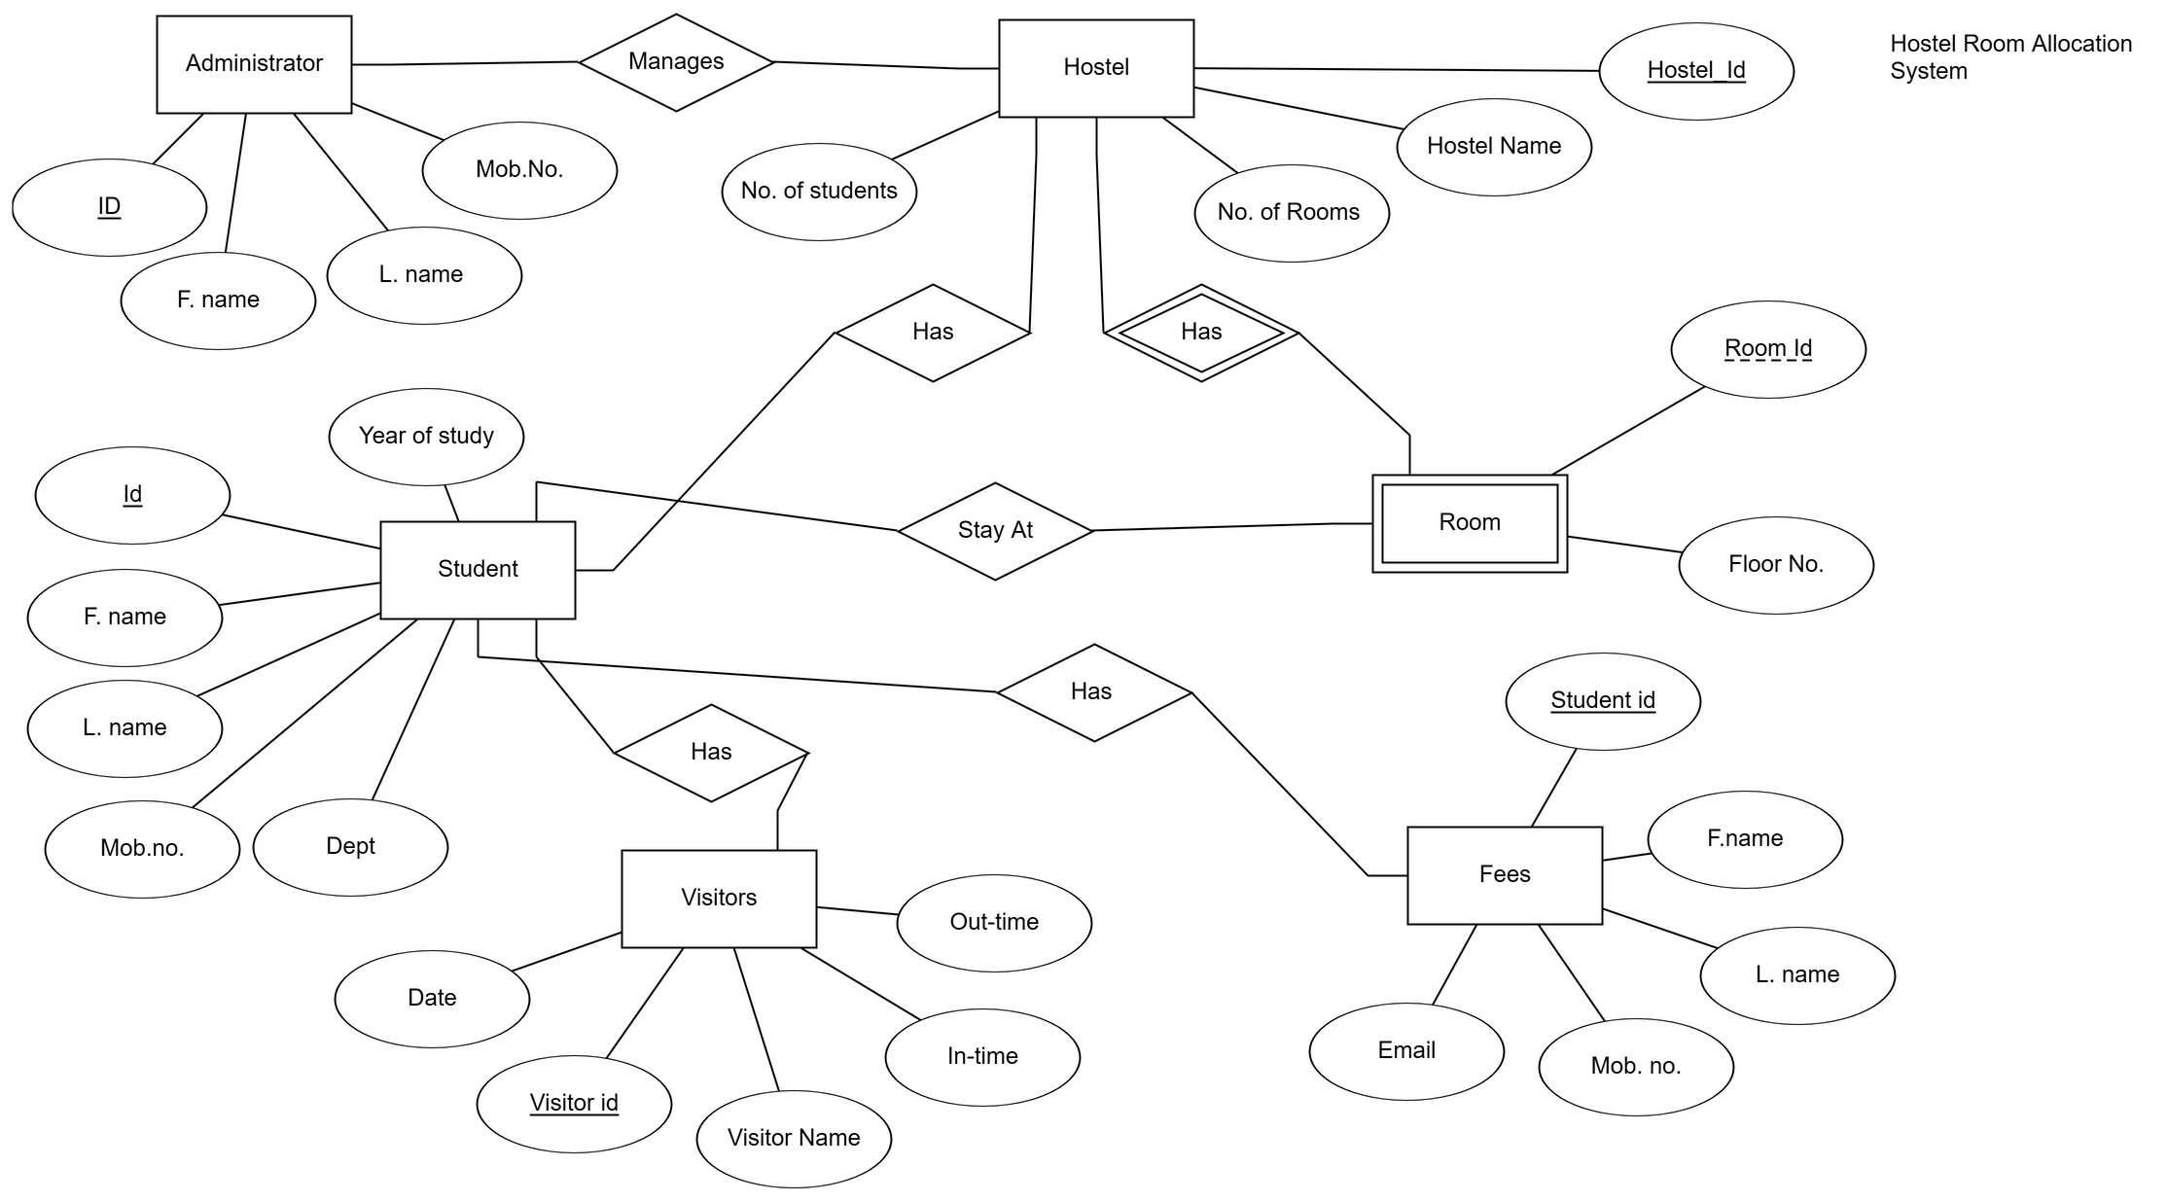
ER Diagram

Slide 4

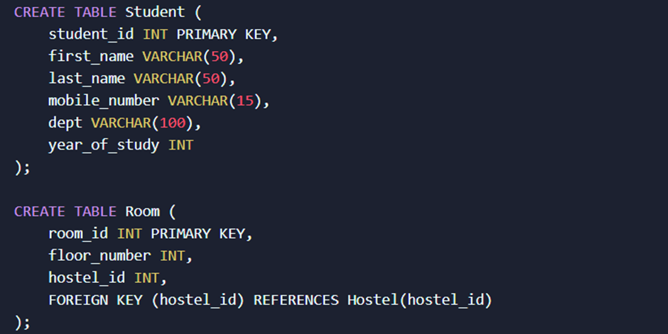

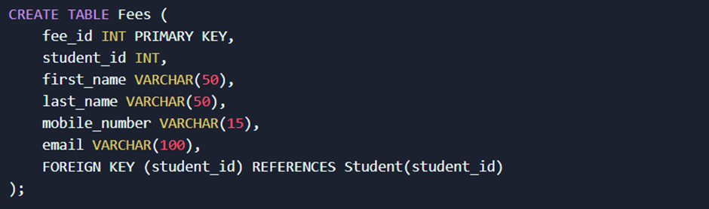
CREATING THE TABLE

Slide 5
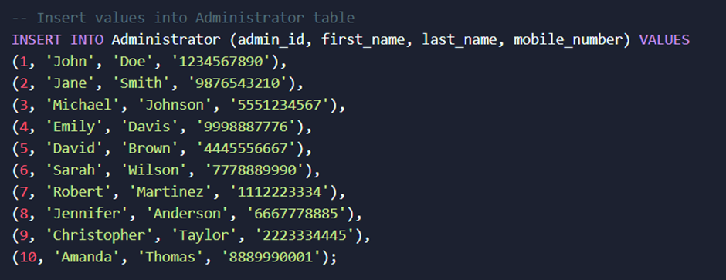
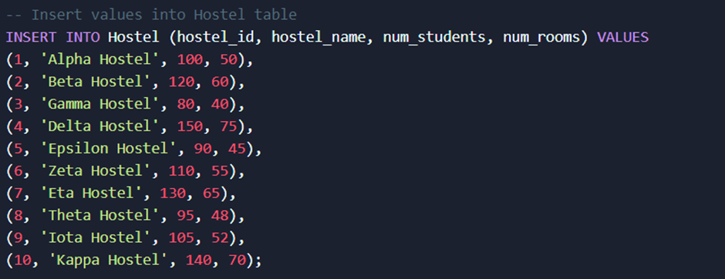
INSERT VALUES

Slide 6
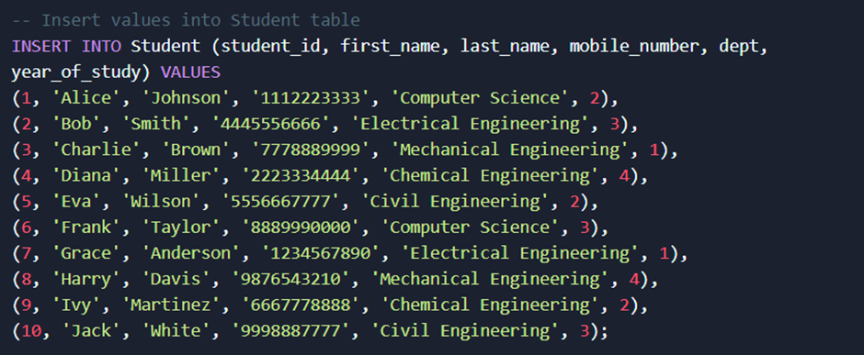
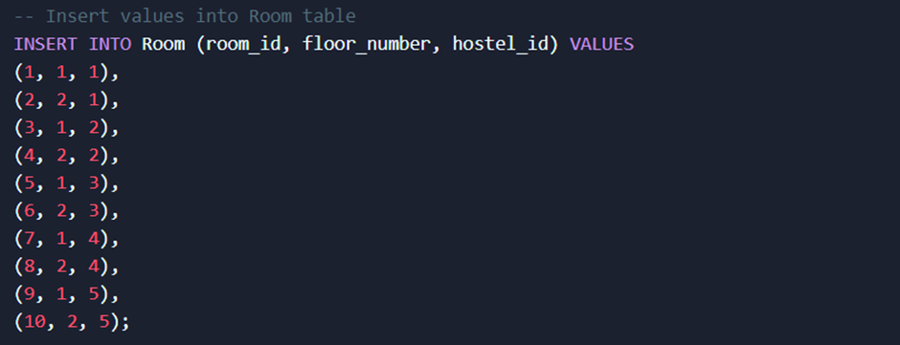
Insert Values

Slide 7
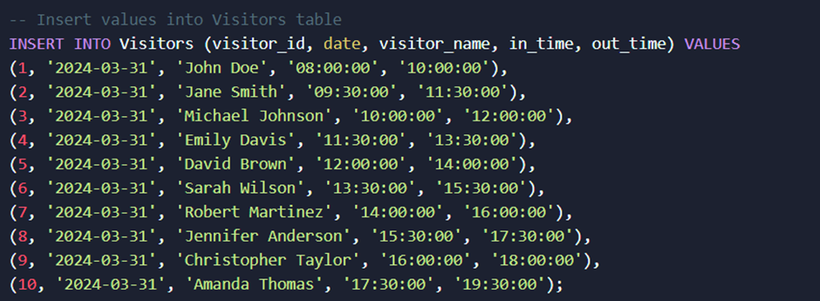
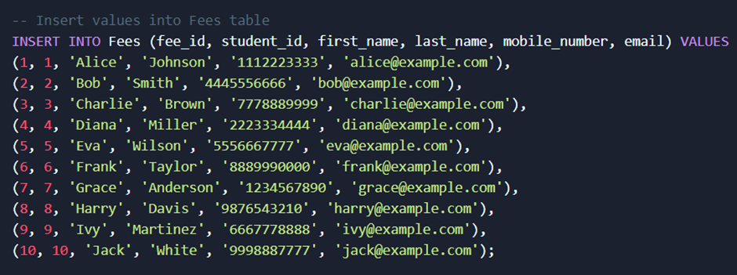

Insert Values

Slide 8





Slide 9



Slide 10





Slide 11





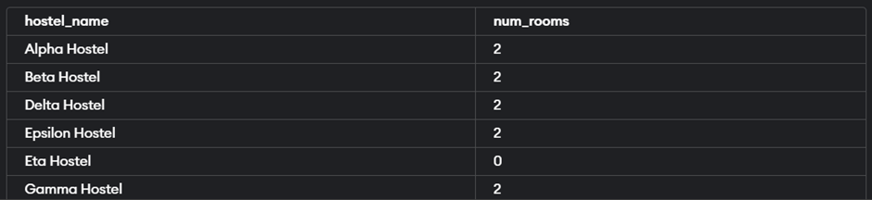


Slide 12



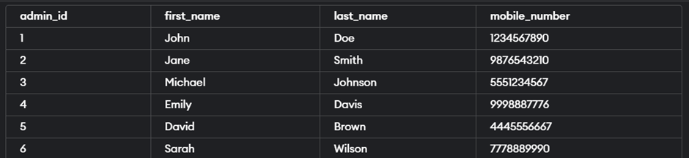



Slide 13
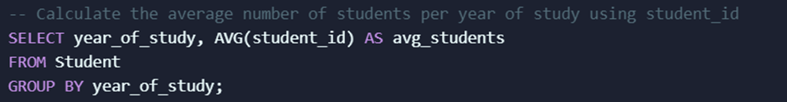


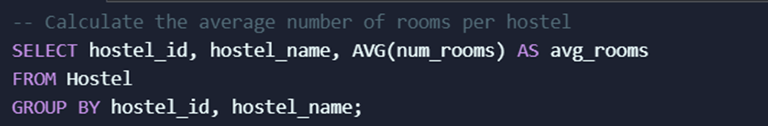

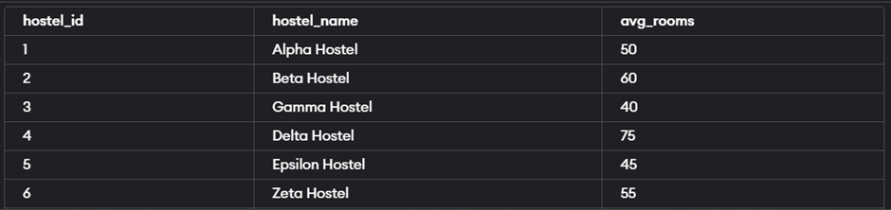


Slide 14

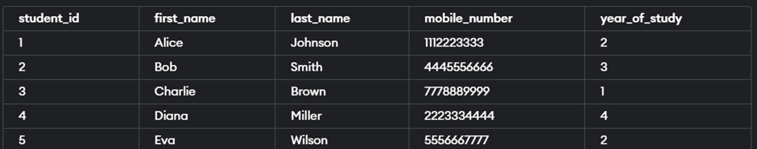



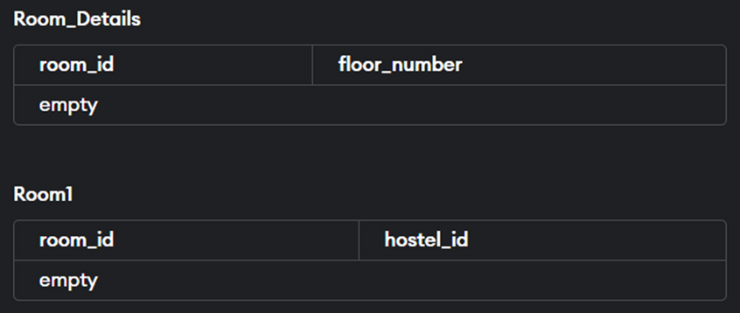


Slide 15


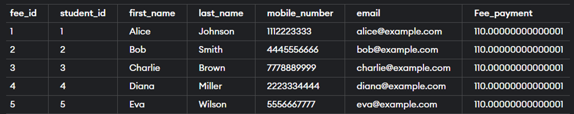
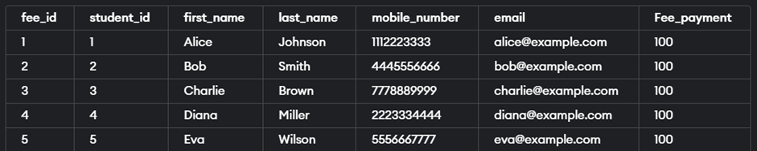



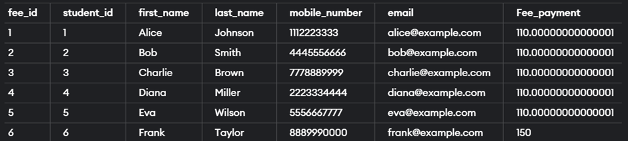


Slide 16
Conclusion
In conclusion, throughout the project, the project allowed me for deep exploration and application of database design principles, query optimization techniques, transaction management strategies. and security measures.
It also provided valuable insights into user interface integration, data validation, error handling, and scalability considerations.
From this project I learned about how transaction management skills with dealing with concurrency issues, implementing transaction control mechanisms, and ensuring ACID properties highlighted the importance of effective transaction management for maintaining data consistency and reliability.

